Slide 1
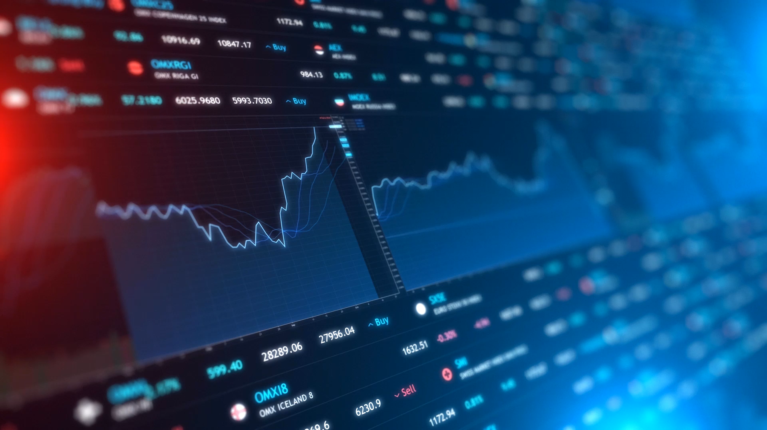
Stock trading with Reinforcement Learning
Final Project Presentation
Jonas | Lorena | Mohamad | Viktoria

Slide 2

Abstract From literature to our concept
Literature research
On Reinforcement Learning (RL)
On sensitivity analysis
Motivation
Trading bot maximizing risk adjusted returns
Explainability behind decisions/trades (xAI)
Novel ideas
Integration of sentiment data per stock among technical indicators
Sensitivity analysis to make explainable and transparent
Enhanced feature engineering and data pre-processing
Notes:
@Jonas

Slide 3


Approach Step by step automated pipeline
Data selection
Model training
Sensitivity analysis
1101001
0001010
0110100
1011001
Data pre-processing
Backtesting
Notes:
@Jonas

Slide 4
Approach Step by step automated pipeline
1101001
0001010
0110100
1011001
Notes:
@Jonas

Slide 5
Data selection Representation of US stock market
30 most important stocks
Apple, Amazon, Microsoft, Tesla, Alphabet…
Two years range: Nov 2021 – Sep 2023
Intraday: Hourly
Interday: Daily
Financial markets data
Alpha Vantage API
OHLCV: Prices and Volume
VIX index
Sentiment data
Financial Modeling Prep API
likes, impressions, sentiment
1101001
0001010
0110100
1011001
Notes:
@Jonas

Slide 6
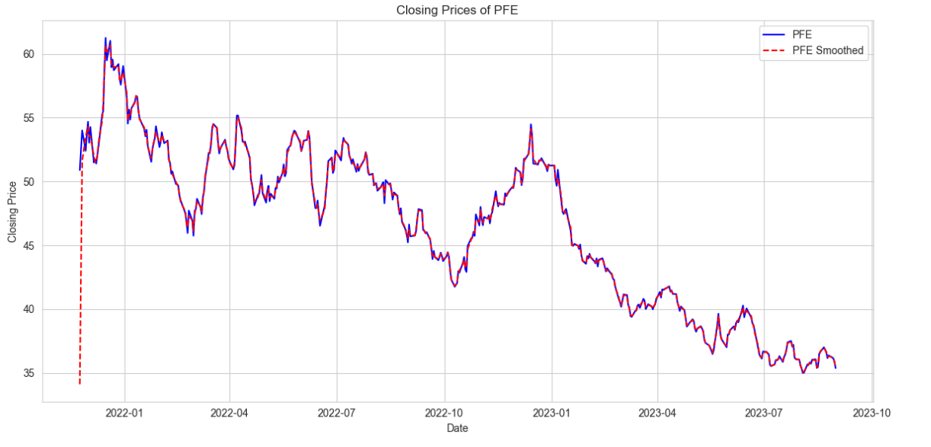
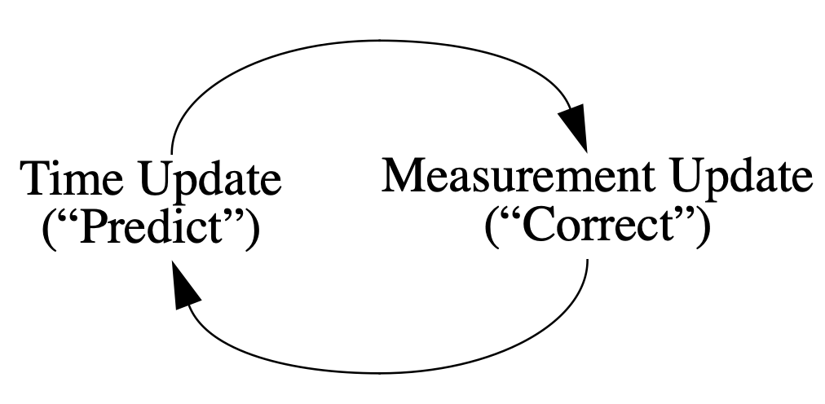
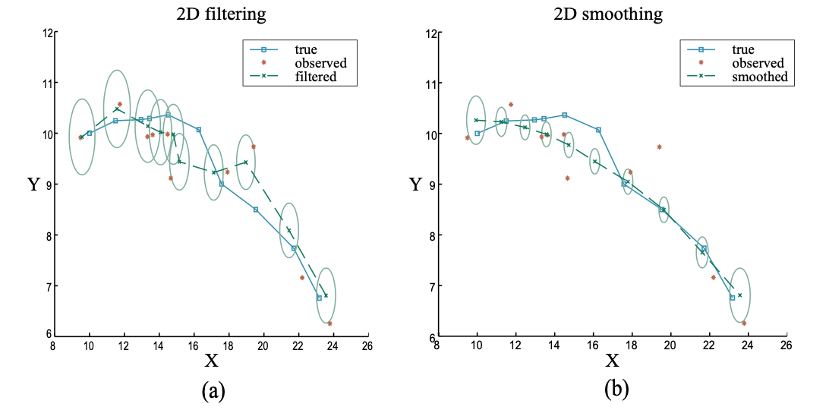
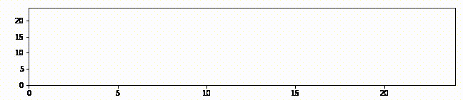
Data pre-processing Step by step automated pipeline
Stock Splits
Technical indicators
MACD, Bollinger Bands, RSI, CCI, …
VIX and turbulence index
Kalman Filter
Test-Train Split (80/20)
Data Normalisation
Log Returns
Min-Max normalisation
Training dataset
Evaluation
1101001
0001010
0110100
1011001
Notes:
@Jonas

Slide 7
Model training Global framework: State, Environment and Agents
Reward: Profit/Loss
Trading Agents
Environment
A2C
Stock prices
Action: sell/hold/buy
Volume
DDPG
{-k, …, -1, 0, 1, …, k}
Portfolio
PPO
Budget
TD3
Tech. Indicators
Sentiment
SAC
Log Returns
State: observations
1101001
0001010
0110100
1011001
Notes:
@Lorena

Slide 8
Model selection Global parameters
Agents
Advantage Actor Critic (A2C)
Proximal Policy Optimization (PPO)
Soft Actor-Critic (SAC)
DDPG
TD3
Approach
Train and improve the hyperparameters:
Model parameters
Sentiment data vs. w/o
Daily/Hourly
Normalized/non-normalized
Risk threshold
Smoothing
Transaction costs
Evaluate and compare with benchmarks
1101001
0001010
0110100
1011001
Notes:
@Lorena

Slide 9
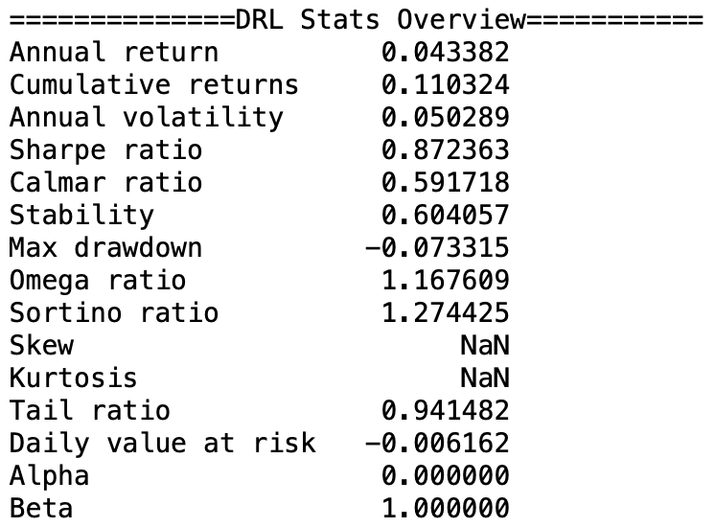
Backtesting Evaluation of trained models
Backtesting: trading on test data
Biases: survivorship, look ahead, sample selection, optimisation, …
Trading: transaction costs, slippage, volume, liquidity
Strategies: trading, portfolio theory and buy & hold
Metrics: Annual/cumulative returns, sharpe/calmar ratio, alpha, beta…
Parameter optimisation
Model parameters
Sentiment data vs. w/o
Daily/Hourly
Normalized/non-normalized
Risk threshold
Smoothing
Transaction costs
1101001
0001010
0110100
1011001
Notes:
@Lorena

Slide 10
Backtesting Evaluation of trained models
Parameter optimisation
Normalized vs non-normalized
1101001
0001010
0110100
1011001

Slide 11
Backtesting Evaluation of trained models
Parameter optimisation
Low vs high transaction costs
1101001
0001010
0110100
1011001

Slide 12
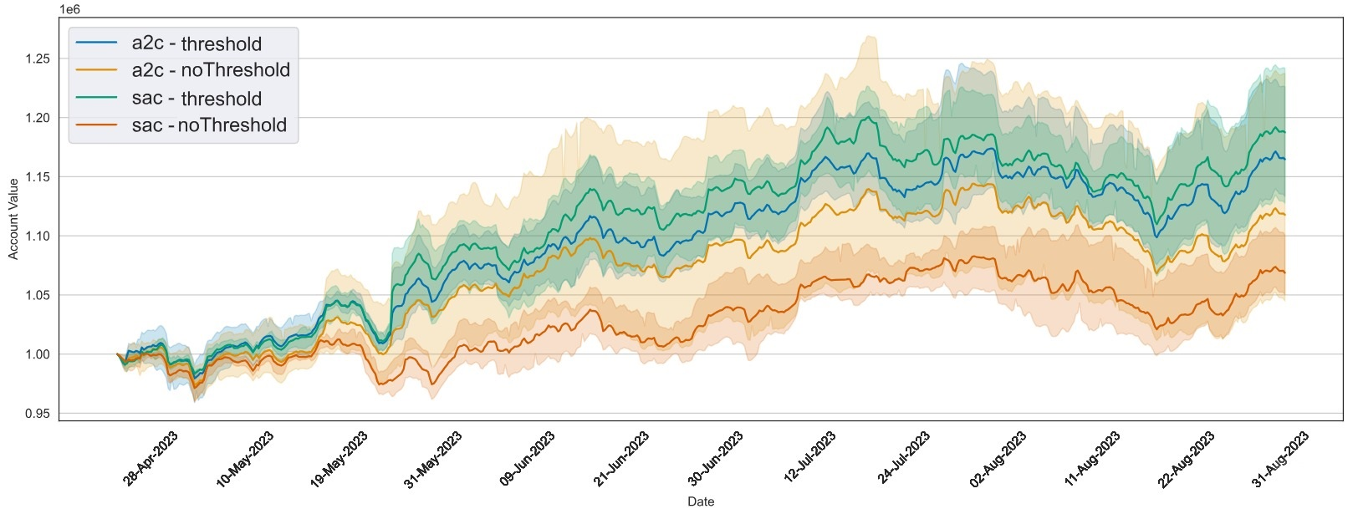
Backtesting Evaluation of trained models
Parameter optimisation
Threshold vs no Threshold
1101001
0001010
0110100
1011001
Notes:
@Lorena

Slide 13
Backtesting Evaluation of trained models
Parameter optimisation
Smoothed vs non-smoothed
1101001
0001010
0110100
1011001
Notes:
@Mohamad

Slide 14
Backtesting Evaluation of trained models
Parameter optimisation
Sentiment vs no Sentiment
Hourly vs Daily
1101001
0001010
0110100
1011001
Notes:
@Mohamad

Slide 15
Backtesting Evaluation of trained models
Parameter optimisation
Sentiment vs no Sentiment
Hourly vs Daily
1101001
0001010
0110100
1011001

Slide 16
Backtesting Evaluation of trained models
Parameter optimisation
Sentiment vs no Sentiment
Hourly vs Daily
1101001
0001010
0110100
1011001

Slide 17
Backtesting Evaluation of trained models
Parameter optimisation
Sentiment vs no Sentiment
Hourly vs Daily
1101001
0001010
0110100
1011001

Slide 18
Backtesting Evaluation of trained models
1101001
0001010
0110100
1011001

Slide 19
Backtesting Evaluation of trained models
1101001
0001010
0110100
1011001

Slide 20
Backtesting Evaluation of trained models
Hourly
Consistently better performance
Daily
Consistently worse performance
1101001
0001010
0110100
1011001

Slide 21
Backtesting Evaluation of trained models
Model choice
Compared to classic strategies
1101001
0001010
0110100
1011001

Slide 22
Backtesting Evaluation of trained models
Model choice
Best models
1101001
0001010
0110100
1011001
Notes:
@Mohamad

Slide 23
Sensitivity analysis Making RL explainable
Basic idea
Analyse gradient of each feature of the state
Features with a consistently large gradient are more important than those with smaller gradients
Intuition for plot interpretation
day/ hour
state feature
1101001
0001010
0110100
1011001
Notes:
@Viki

Slide 24
Sensitivity analysis Making RL explainable
Basic idea
Analyse gradient of each feature of the state
Features with a consistently large gradient are more important than those with smaller gradients
Intuition for plot interpretation
Which features are the most important?
day/ hour
state feature
1101001
0001010
0110100
1011001

Slide 25
Sensitivity analysis Making RL explainable
Basic idea
Analyse gradient of each feature of the state
Features with a consistently large gradient are more important than those with smaller gradients
Intuition for plot interpretation
Which features are the most important?
Which stocks are the most important?
day/ hour
state feature
1101001
0001010
0110100
1011001

Slide 26
Sensitivity analysis Making RL explainable
Basic idea
Analyse gradient of each feature of the state
Features with a consistently large gradient are more important than those with smaller gradients
Intuition for plot interpretation
Which features are the most important?
Which stocks are the most important?
Which days are the most influential?
day/ hour
state feature
1101001
0001010
0110100
1011001

Slide 27
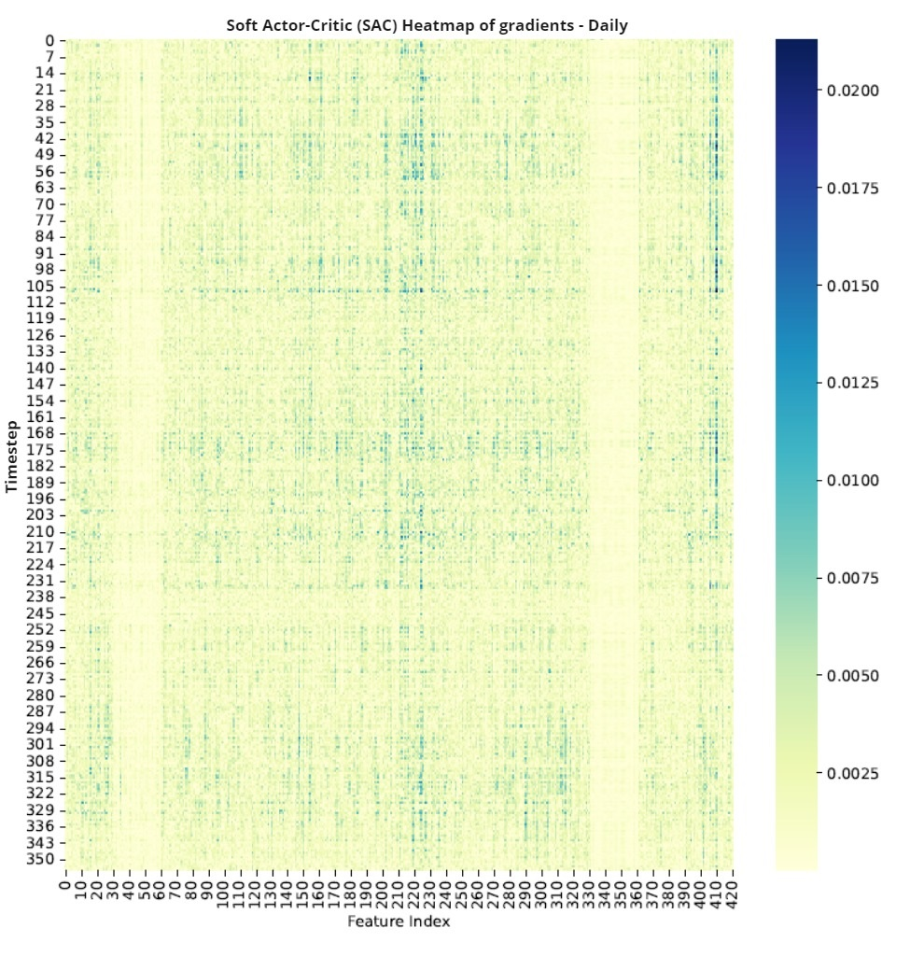
Sensitivity analysis Making RL explainable
Basic idea
Analyse gradient of each feature of the state
Features with a consistently large gradient are more important than those with smaller gradients
Intuition for plot interpretation
Which features are the most important?
Which stocks are the most important?
Which days are the most influential?
1101001
0001010
0110100
1011001

Slide 28
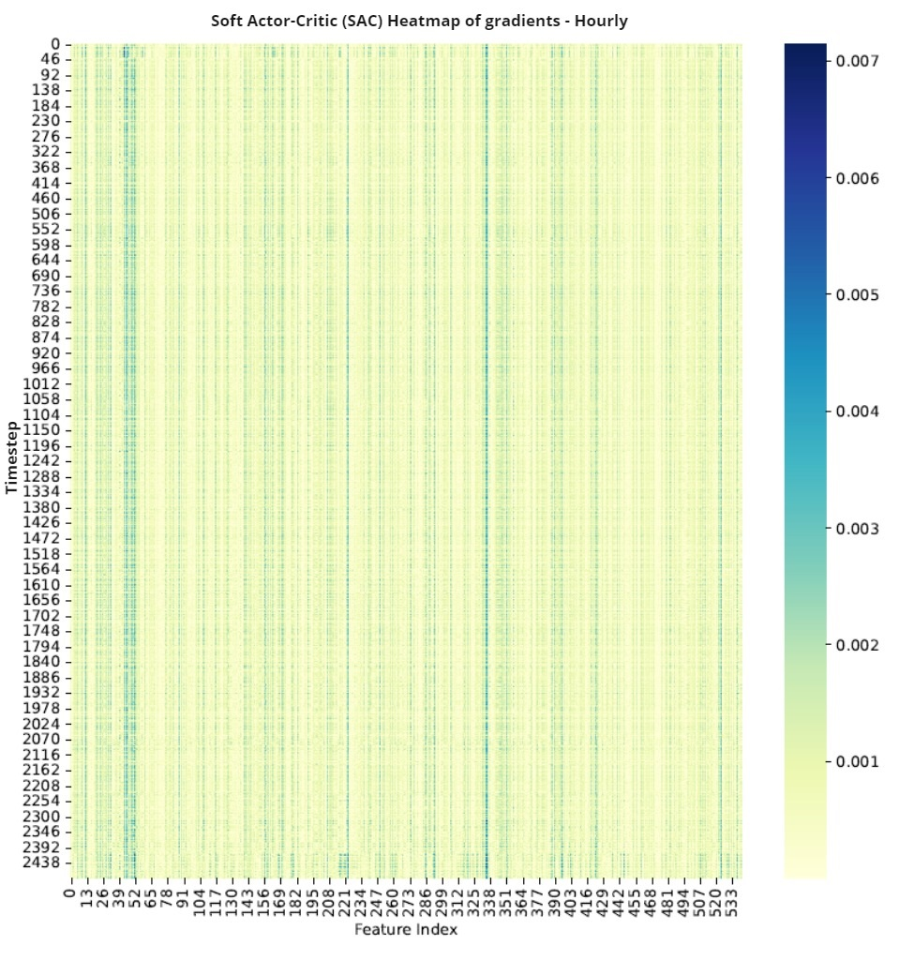
Sensitivity analysis Making RL explainable
Intuition for plot interpretation
Which features are the most important?
Which stocks are the most important?
Which days are the most influential?
1101001
0001010
0110100
1011001

Slide 29
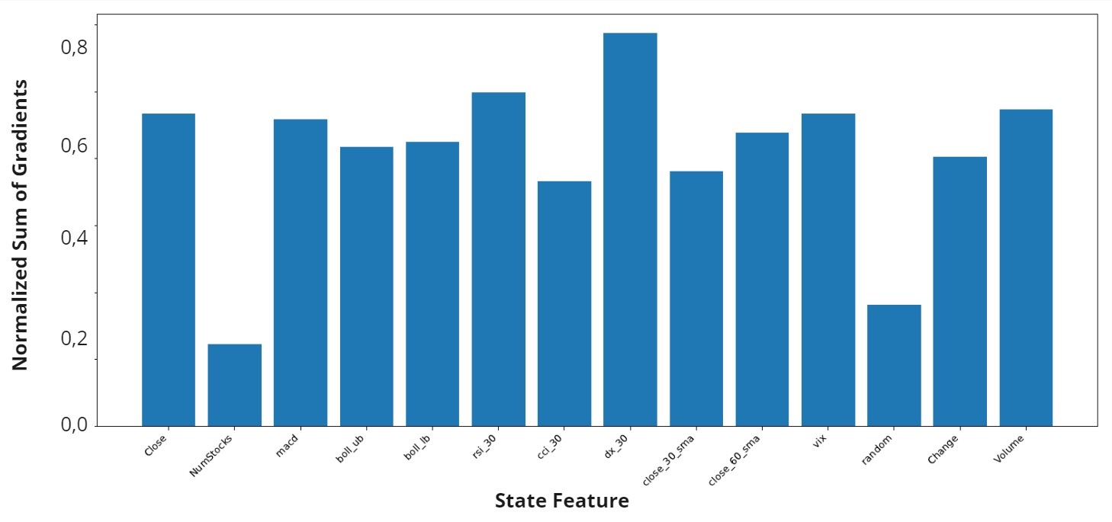
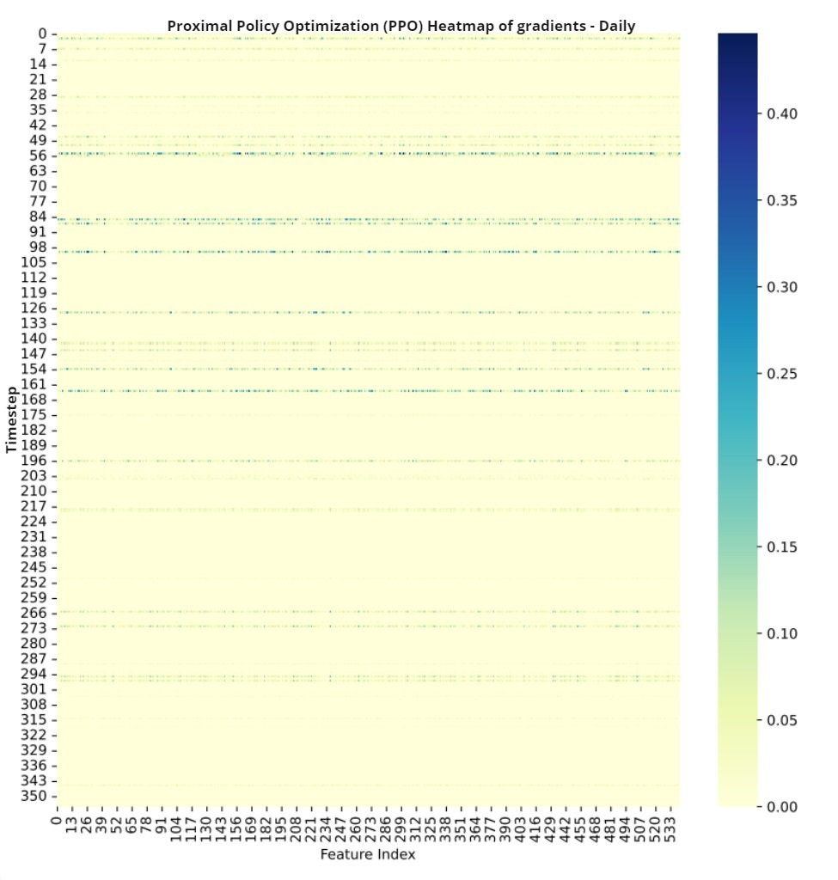
Sensitivity analysis Making RL explainable
Intuition for plot interpretation
Which features are the most important?
Which stocks are the most important?
Which days are the most influential?
1101001
0001010
0110100
1011001

Slide 30
Sensitivity analysis Making RL explainable
Intuition for plot interpretation
Which features are the most important?
Which stocks are the most important?
Which days are the most influential?
1101001
0001010
0110100
1011001

Slide 31
Sensitivity analysis Making RL explainable
Intuition for plot interpretation
Which features are the most important?
Which stocks are the most important?
Which days are the most influential?
1101001
0001010
0110100
1011001

Slide 32


Summary and Outlook Obstacles, dead ends and novel approaches
Obstacles
The sensitivity analysis could not exclude features
Could not re-train with new reduced data set
The hyperparameters could not be further improved
Overall low signal-to-noise ratio
Novel ideas
Replace sentiment data with fundamental/senate trading/weather/… other alternative data
Stronger focus on data and feature engineering: follow different approaches to produce stable signals from noisy data
→ Both approaches outside of actual reinforcement learning
Notes:
@Jonas/Mohamad

Slide 33
Q
&
A

